Slide 1
Grocery Sales Market Basket Analysis and Apriori Model for Association Rule Mining
Analyzing Item Sales Trends and Identifying Frequent Item sets
By Rounak Pyne

Slide 2
Agenda
Introduction
Data Overview
Data Preprocessing
Data Visualization
Apriori Algorithm and Model Creation
Results and Insights
Conclusion

Slide 3
Introduction
Objective:
To analyze the sales data from a grocery store.
To implement the Apriori algorithm to find association rules and identify frequent item sets.

Slide 4
Data Overview
Dataset: Groceries_dataset.csv
Features:
Member_number: Unique ID for customers
Date: Date of transaction
itemDescription: Name of items sold
Initial Steps:
Loaded dataset and created a backup for safety.
Checked for missing values and data types.

Slide 5
Data Pre-processing
Date Conversion:
Converted the 'Date' column to the correct datetime format for further analysis.
Null Values:
Checked for null values (result: no null values).

Slide 6
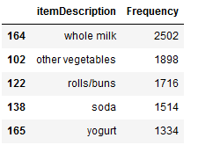
Distribution of Items Sold
Analysis: Grouped the data by itemDescription to get the frequency of items sold.

Slide 7
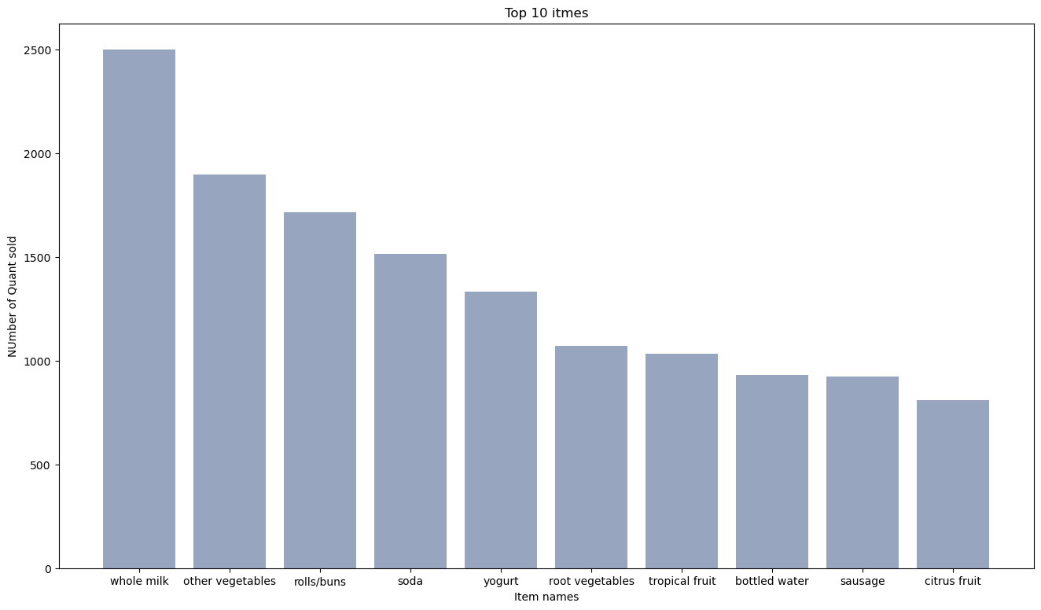
Visualization – Top 10 Items Sold
Bar Graph:
Plotted the top 10 most sold items using a bar chart.
Graph Sample:
Shows item names on the x-axis and quantity sold on the y-axis.

Slide 8
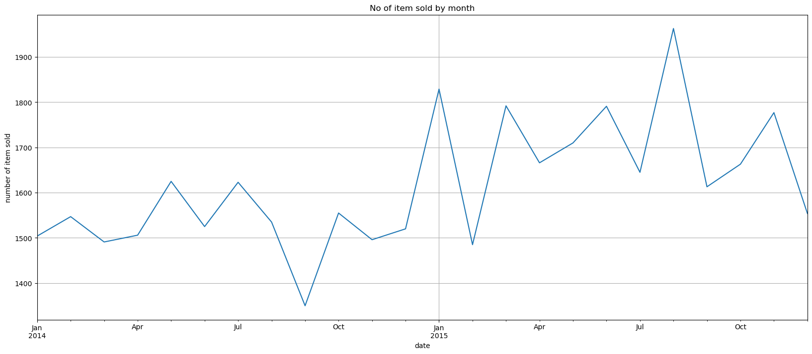
Time Series Analysis
Objective: To understand the sales trend over time.
Step: Resampled the data by month and plotted a time series graph for items sold monthly.
Plot: Number of items sold by month.

Slide 9
Preparing Data for Apriori Algorithm
Customer-Level Data:
Grouped data by Member_number and itemDescription.
Removed whitespaces in itemDescription.
Transactions:
Combined all transactions for each customer into a list format.

Slide 10
Apriori Algorithm
Objective: To find frequent itemsets and association rules using the Apriori algorithm.
Parameters:
min_support = 0.002
min_confidence = 0.05
min_lift = 3
Results: Stored in a list format for further analysis.

Slide 11
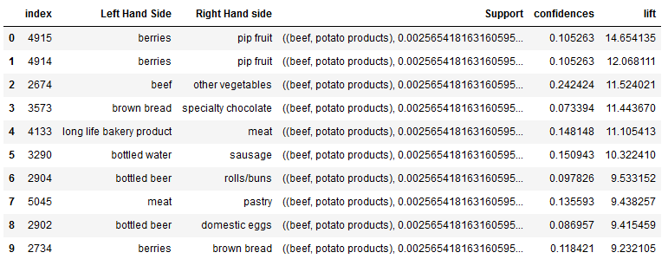
Extracting and Displaying Results
Metrics Extracted:
Left Hand Side (LHS): Itemsets in transactions.
Right Hand Side (RHS): Associated item.
Support, Confidence, Lift.

Slide 12
Top 10 Association Rules
Table of Results:
Display the top 10 association rules based on lift.
Columns: LHS, RHS, Support, Confidence, Lift.

Slide 13
Insights from the Apriori Algorithm
Frequent Itemsets:
Identified frequently bought items together.
Business Use:
Insights for cross-selling, marketing strategies, and inventory management.

Slide 14
Conclusion
Key Takeaways:
Time-series analysis revealed sales trends.
The Apriori algorithm helped find valuable item sets for better business decisions.
Next Steps:
Further fine-tune parameters in the Apriori algorithm.
Implement strategies based on association rules.

Slide 15
Thank You
Rounak Pyne
Contact - rounakpyne.official@gmail.com

